Slide 1
Nagios Monitoring
Continuous Monitoring Concepts, Installation & Configuration

Slide 2
Continuous Monitoring Concepts
Real-time tracking of IT systems, servers, and applications
Ensures uptime, detects failures early, minimizes downtime
Benefits:
• Proactive issue detection
• Improved system reliability
• Better security compliance
• Reduced MTTR

Slide 3
Introduction to Nagios
Open-source monitoring tool
Tracks servers, networks, and applications
Key Features:
• Alerts & notifications
• Plugins for customization
• Web interface for visualization

Slide 4
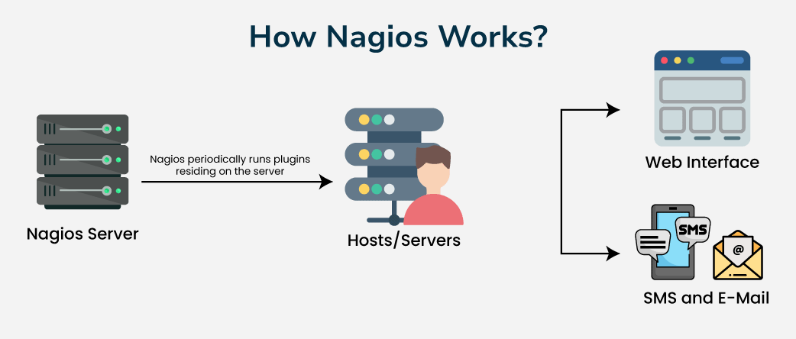

Slide 5
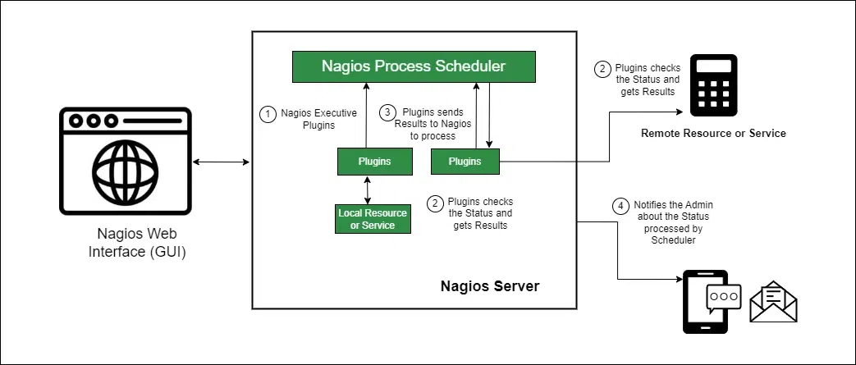
Architecture

Slide 6
Nagios Plugins
Executables/scripts used to monitor services
- Examples: check_http, check_ping, check_disk
- Soft and Hard States:
Soft state: Temporary failure
Hard state: Confirmed failure after retries

Slide 7
Installation of Nagios
Methods:
• Using Package Managers: apt-get, yum, rpm
• Compiling from Source
Steps:
1. Install prerequisites
2. Download Nagios Core
3. Compile and install
4. Configure Nagios user and groups
5. Start Nagios service

Slide 8
Setting up Web Server
Provides web interface
Components: Apache + PHP
Steps:
1. Configure Apache virtual host
2. Enable CGI for Nagios
3. Create Nagios admin account
4. Access via http://<server_ip>/nagios

Slide 9
Command-Line Interfaces
Tools:
nagios -v /etc/nagios/nagios.cfg
systemctl restart nagios
tail -f /usr/local/nagios/var/nagios.log
Use Case: Troubleshooting & automation

Slide 10
Nagios Configuration
Core Config Files:
nagios.cfg
hosts.cfg
services.cfg
Monitoring Examples:
• Web servers
• Databases
• Disk & CPU usage

Slide 11
Web Interface (GUI)
Features:
• Host & service status
• Downtime scheduling
• Acknowledging problems
• Viewing performance graphs
Navigation: Hosts → Services → Alerts → Notifications

Slide 12
Installing Nagios on Ubuntu 22.04
Step-by-step installation

Slide 13
Introduction
Nagios is a powerful IT infrastructure monitoring tool.
- Monitors ongoing host activities
- Issues alerts if problems occur
- Available for Linux and Microsoft OS
- Ubuntu 22.04 LTS is the latest release

Slide 14
Step 1: Update Packages
Update Ubuntu system packages:
sudo apt update

Slide 15
Step 2: Install Dependencies
Install Apache, PHP, OpenSSL, and other required dependencies:
sudo apt install wget unzip curl openssl build-essential libgd-dev libssl-dev libapache2-mod-php php-gd php apache2

Slide 16
Step 3: Download Nagios
Download the Nagios tar.gz file:
wget https://assets.nagios.com/downloads/nagioscore/releases/nagios-4.4.6.tar.gz
Extract the file:
sudo tar -zxvf nagios-4.4.6.tar.gz
cd nagios-4.4.6

Slide 17
Step 4: Configure and Compile
Run configure script:
sudo ./configure
Compile using make:
sudo make all
Create Nagios user & group:
sudo make install-groups-users
Add Apache user to Nagios group:
sudo usermod -a -G nagios www-data

Slide 18
Step 5: Install Nagios
Install Nagios:
sudo make install
Install command mode:
sudo make install-commandmode
Install configuration files:
sudo make install-config

Slide 19
Step 6: Configure Apache
Install web interface:
sudo make install-webconf
Enable Apache modules:
sudo a2enmod rewrite
sudo a2enmod cgi
Set firewall rules:
sudo ufw allow apache
sudo ufw enable
sudo ufw reload
Restart Apache:
sudo systemctl restart apache2

Slide 20
Step 7: Create Nagios User
Create a Nagios admin user (example: linuxhint):
sudo htpasswd -c /usr/local/nagios/etc/htpasswd.users linuxhint
Set password for the user

Slide 21
Step 8: Install Nagios Plugins
Download plugins:
sudo wget https://nagios-plugins.org/download/nagios-plugins-2.3.3.tar.gz
Extract:
sudo tar -zxvf nagios-plugins-2.3.3.tar.gz
cd nagios-plugins-2.3.3
Configure:
sudo ./configure --with-nagios-user=nagios --with-nagios-group=nagios
Install:
sudo make install

Slide 22
Verify Installation
Check Nagios version:
sudo /usr/local/nagios/bin/nagios –v
http://127.0.0.1:8080/nagios if not working follow next step
Expected output: Nagios Core 4.4.6 installed successfully.

Slide 23
Create Nagios Config File
sudo nano /etc/apache2/sites-available/nagios.conf
ScriptAlias /nagios/cgi-bin "/usr/local/nagios/sbin"
<Directory "/usr/local/nagios/sbin">
Options ExecCGI
AllowOverride None
Require all granted
AuthName "Nagios Access"
AuthType Basic
AuthUserFile /usr/local/nagios/etc/htpasswd.users
Require valid-user
</Directory>

Slide 24
Cont..
Alias /nagios "/usr/local/nagios/share"
<Directory "/usr/local/nagios/share">
Options None
AllowOverride None
Require all granted
AuthName "Nagios Access"
AuthType Basic
AuthUserFile /usr/local/nagios/etc/htpasswd.users
Require valid-user
</Directory>

Slide 25
Enable and Restart Apache
sudo a2ensite nagios.conf
sudo a2enmod cgi
sudo systemctl restart apache2
Create Nagios Web User (if not already)
sudo htpasswd -c /usr/local/nagios/etc/htpasswd.users nagiosadmin
Check output
http://127.0.0.1:8080/nagios

Slide 26
Step 1: Run Nagios Manually
sudo /usr/local/nagios/bin/nagios /usr/local/nagios/etc/nagios.cfg

Slide 27
Step 2: Fix Systemd Service File
sudo nano /etc/systemd/system/nagios.service
[Unit]
Description=Nagios Core Monitoring Service
BindTo=network.target
[Service]
Type=forking
ExecStart=/usr/local/nagios/bin/nagios -d /usr/local/nagios/etc/nagios.cfg
ExecStop=/usr/local/nagios/bin/nagios -s /usr/local/nagios/var/nagios.lock
User=nagios
Group=nagios
[Install]
WantedBy=multi-user.target

Slide 28
sudo systemctl daemon-reexec
sudo systemctl daemon-reload

Slide 29
Step 3: Recreate Command Pipe
cd ~/nagios-4.4.6
sudo make install-commandmode
Fix permissions:
sudo chown -R nagios:nagios /usr/local/nagios/var/rw
sudo chmod -R 775 /usr/local/nagios/var/rw
sudo usermod -a -G nagios www-data

Slide 30
Step 4: Start Service
sudo systemctl start nagios
sudo systemctl status nagios

Slide 31
If still failed nagios then follow below
Step 1: Remove Old Lock File
sudo rm -f /run/nagios.lock
sudo rm -f /usr/local/nagios/var/nagios.lock

Slide 32
Step 2: Recreate Lock Directory with Correct Ownership
sudo touch /usr/local/nagios/var/nagios.lock
sudo chown nagios:nagios /usr/local/nagios/var/nagios.lock
sudo chmod 664 /usr/local/nagios/var/nagios.lock

Slide 33
Also fix /run lock:
sudo touch /run/nagios.lock
sudo chown nagios:nagios /run/nagios.lock
sudo chmod 664 /run/nagios.lock

Slide 34
Step 3: Restart Nagios
sudo systemctl restart nagios
sudo systemctl status nagios

Slide 35
Deploying a Simple Web App
Scenario: Monitor a web app
Steps:
1. Deploy web app (Apache + PHP)
2. Configure check_http plugin
3. Set notification rules
4. Validate alerts and logs

Slide 36
sudo apt update
sudo apt install apache2 php libapache2-mod-php -y

Slide 37
sudo nano /var/www/html/index.php
<?php
// Simple Web App for Nagios Monitoring
echo "<h1>My First Web App</h1>";
echo "<p>Status: Application is running fine ✅</p>";
echo "<p>Server Time: " . date("Y-m-d H:i:s") . "</p>";
?>

Slide 38
Fix permissions
sudo chown www-data:www-data /var/www/html/index.php
sudo chmod 644 /var/www/html/index.php

Slide 39
sudo systemctl restart apache2
Test the browser

